Slide 1
Graphics Processing Unit (GPU)
What Is It?

Slide 2
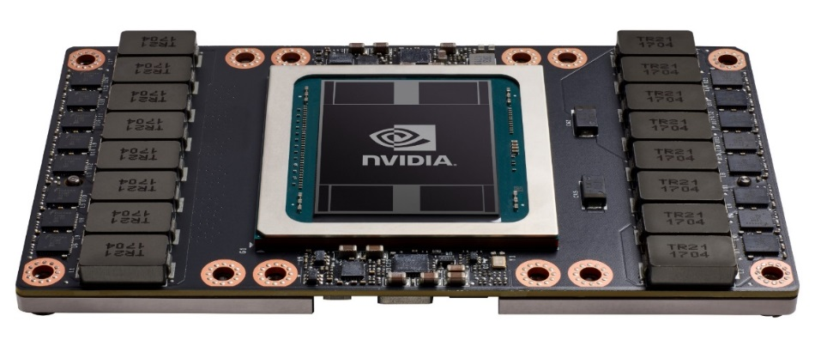
GPUs
Graphics processing unit
Initially, graphics cards
Now, may or may not contain video outputs!
Must use a specialized library (CUDA) to program
Contain many thousands of cores
Power hungry (200–300 W)
PCIe interface, just plug in!
V-100 GPU naked

Slide 3
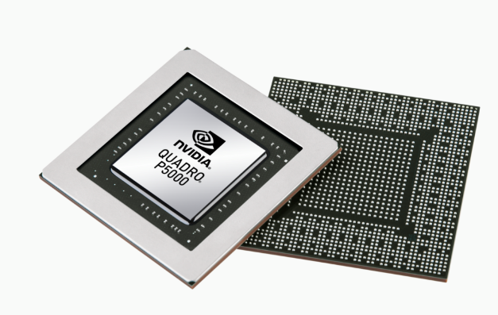
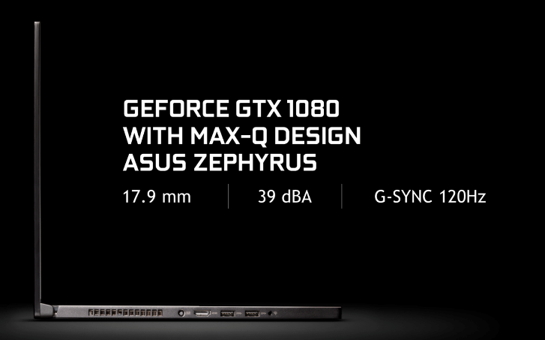
Laptop GPUs
Lightweight and powerful
Quadro P5200 mobile
16G
heavier
GTX 1080 with MAX-Q design
8G
thinner
Best value with consumer grade cards

Slide 4
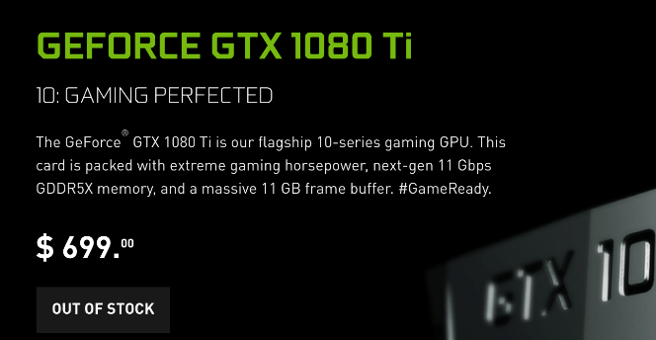
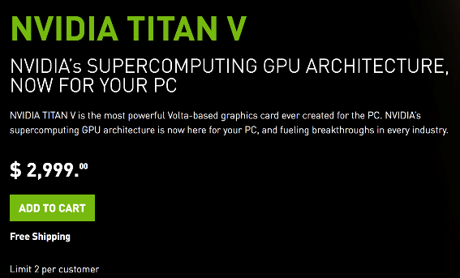
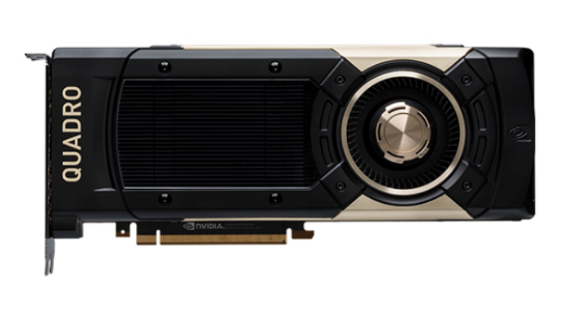
Desktop GPUs
The power on your desk
Pascal architecture
11G
Volta architecture
12G
Quadro GV 1000
Volta architecture
24G
$8,999
Best value with consumer grade cards
Consumer
Enterprise

Slide 5
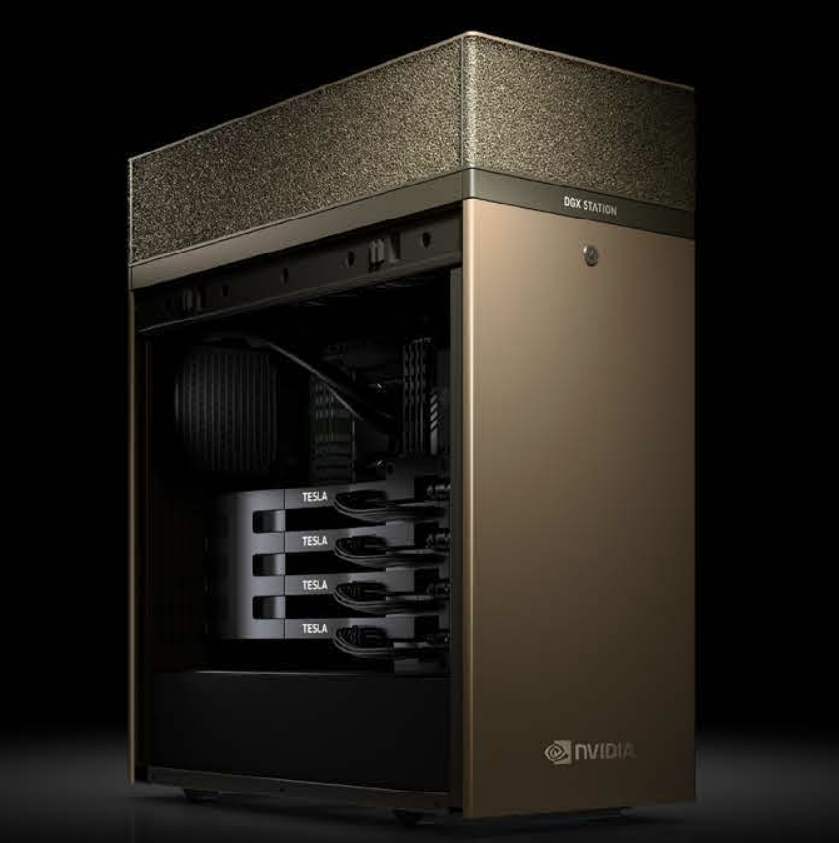
NVIDIA DGX Station
The most powerful DL desktop money can buy
4x V-100 GPUs
128 GB RAM
Intel Xeon E5-2698 v4 2.2 GHz (20-core)
NVLink

Slide 6
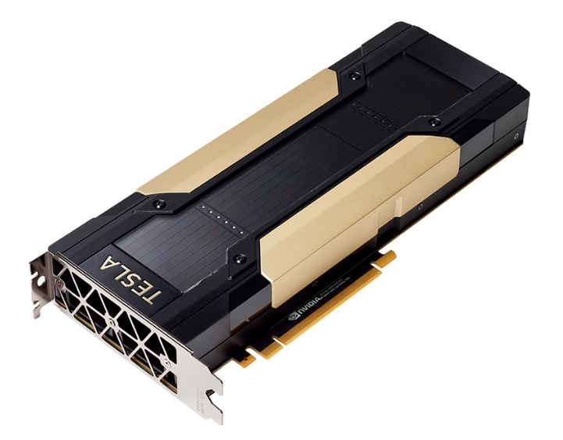
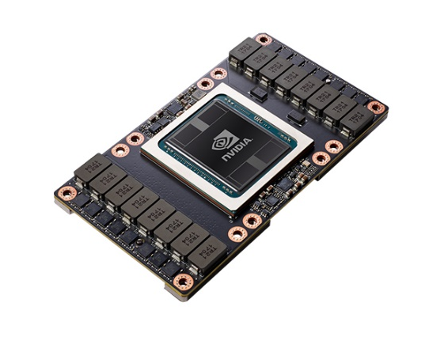
Cloud GPUs
Best available performance, but it comes at a cost
With NVLink 2
300 GB/s interconnect
PCIe
32 GB/s interconnect
Could plug into existing “legacy” servers

Slide 7
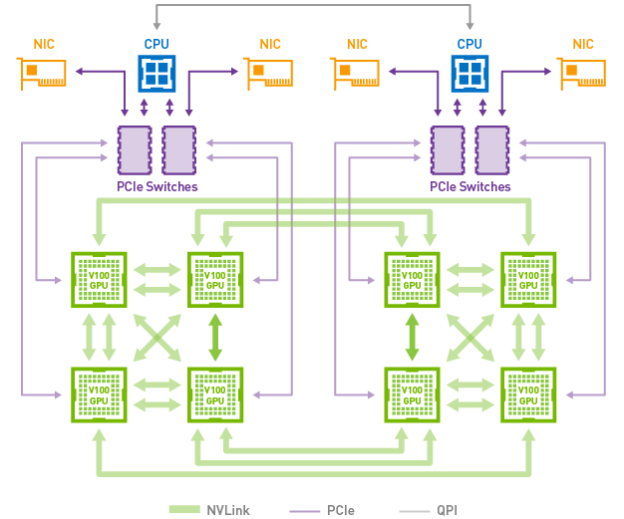
NVLink and DGX-1
GPUs are connected via a hybrid cube mesh

Slide 8
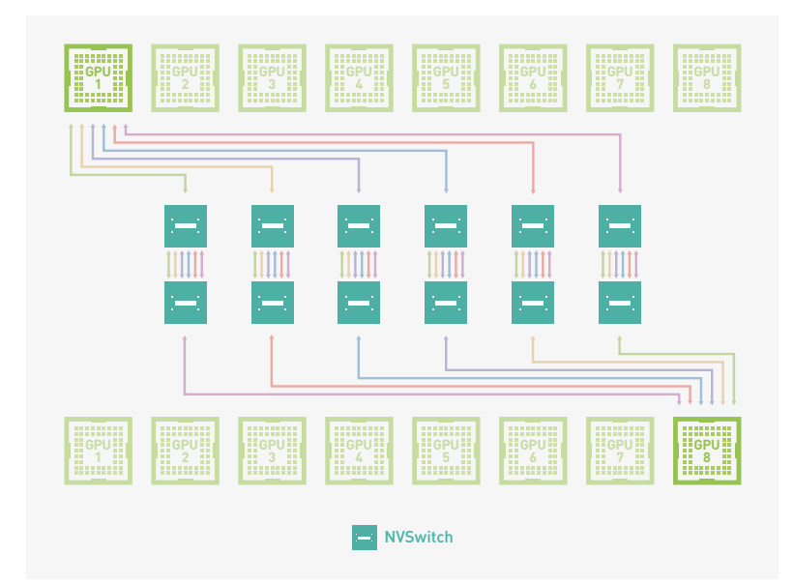
NVSwitch
Designed for DGX-2, which connects 16 GPUs at a cumulative 300 GB/s

Slide 9
Low-Power GPUs and TPUs

Slide 10
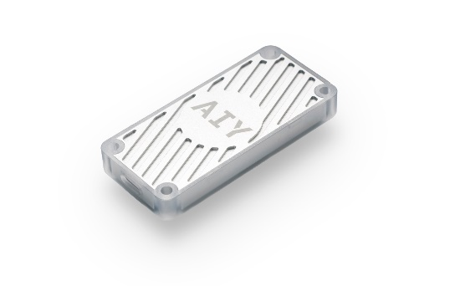
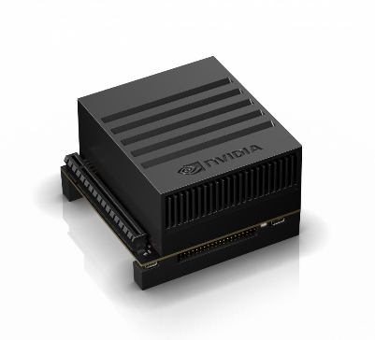
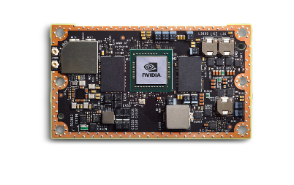
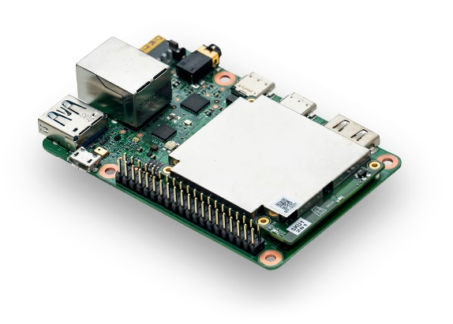
Low Power DL Engines
Explosive growth
GPUs
TPUs
Jetson TX2
Jetson Xavier
256 core Pascal GPU
4 core ARM v8 + 2 Denver cores
8 GB LPDDR4x
16GB eMMC
512 core Volta GPU
8 core ARM v8
16 GB LPDDR4x
32GB eMMC
Coming in fall 2018
20x performance
10x energy efficiency

Slide 11
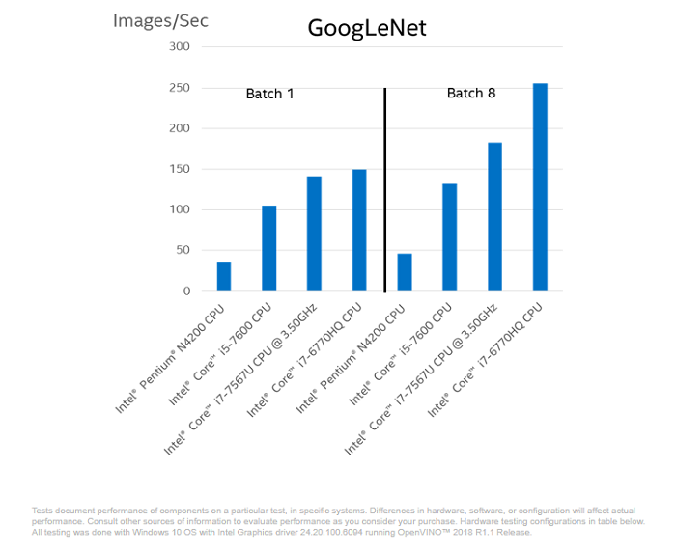
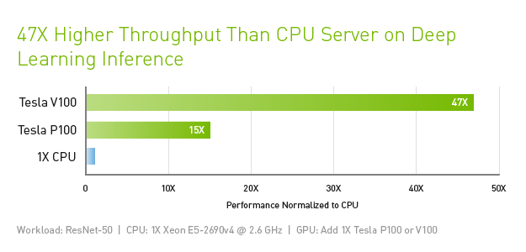
CPUs for DL
Yes, you can use CPUs, but mainly for inference
It is very tempting to use existing CPU infrastructure (e.g., Big DL)
Download the latest Intel MKL-DNN libraries and Intel-optimized frameworks (e.g., TensorFlow)
Running on a cluster may also work
But, consider just inserting GPUs into existing machines
New CPUs are benchmarked for DL

Slide 12
FPGA
Integrated circuit designed to be configured by a customer or a designer after manufacturing—hence “field-programmable”
Contain an array of programmable logic blocks, and a hierarchy of reconfigurable interconnects
Allow the blocks to be “wired together,” like many logic gates that can be inter-wired in different configurations
Logic blocks can be configured to perform complex combinational functions, or merely simple logic gates like AND and XOR
Low power consumption, “performance per watt” is very high

Slide 13
System on a Chip (SoC)
Custom microchip to perform a specific function
Approximately 10 times better performance than FPGA system on the same technology node, and more in some specific architectures
Single purpose only

Slide 14
Tensor Processing Unit (TPU)
AI accelerator application-specific integrated circuit (ASIC) developed by Google specifically for neural network machine learning
Used in Google data centers for a year before public announcement in 2016
Specifically designed for Google's TensorFlow framework
Proprietary; not commercially available
Available to use through Google Cloud
Deliver 15–30 times higher performance and 30–80 times higher performance-per-watt than contemporary CPUs and GPUs
Designed to be flexible enough to accelerate the computations needed to run many different kinds of neural network models

Slide 15
Digital Signal Processor (DSP)
Primarily used in telecom systems
Previous-gen chip that can be repurposed for deep learning
Performance not on par with other hardware

Slide 16
How to Choose?
Different hardware to solve different problems
Consider power and performance requirements
Learning/evaluating at the edge has power limitations
Learning/evaluating in the cloud can use more wattage
Is custom hardware an option? Or does off-the-shelf make more sense?

